Slide 1

Coin Pilot

Slide 2
Our Members
Introduction of the group and members (where based, uni, studying)
Technologies used and why they were chosen
Tests, language and purpose
Relevance to Citi
Most useful prompts found
Q and A

Slide 3
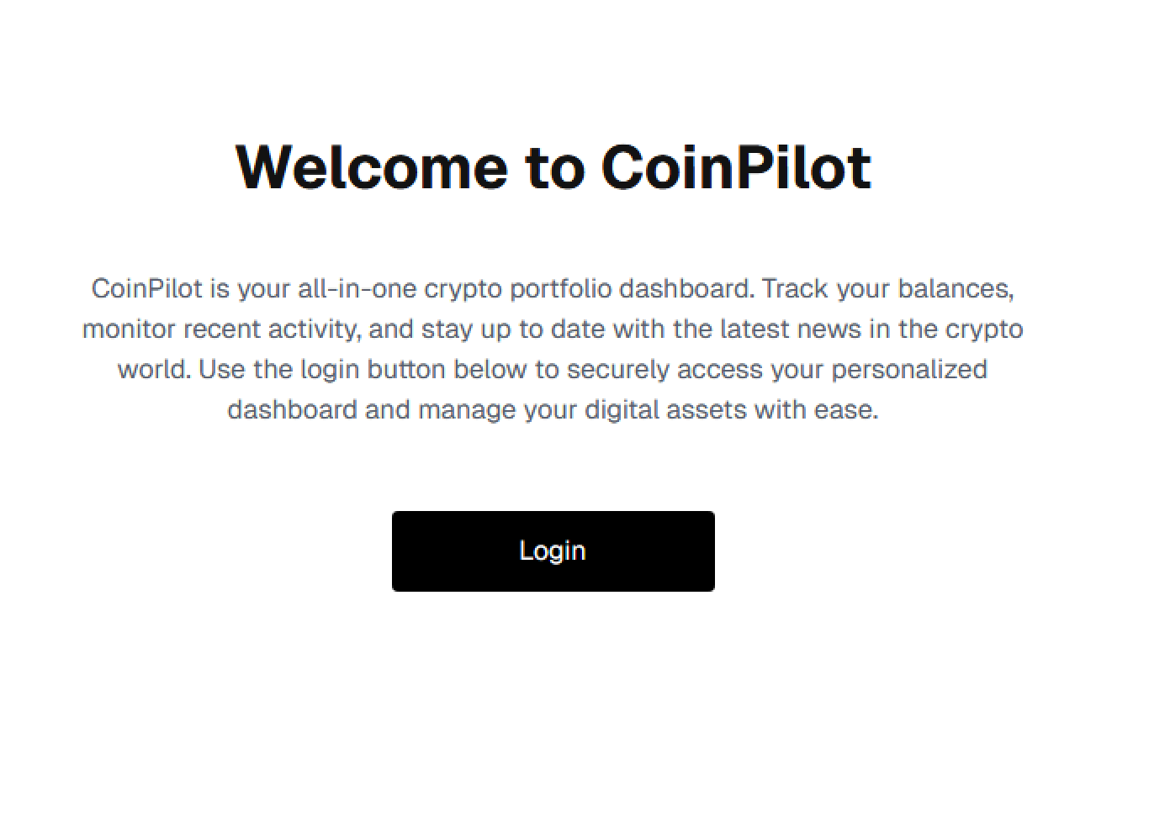
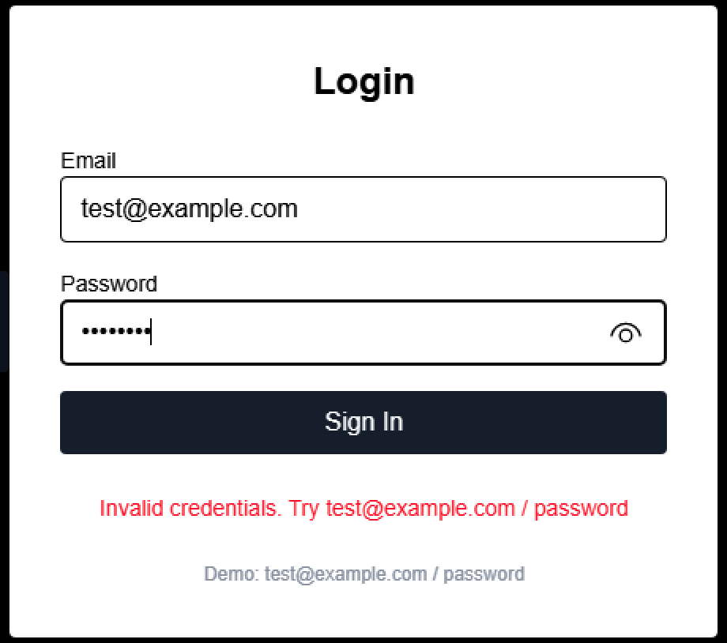
Login Page

Slide 4
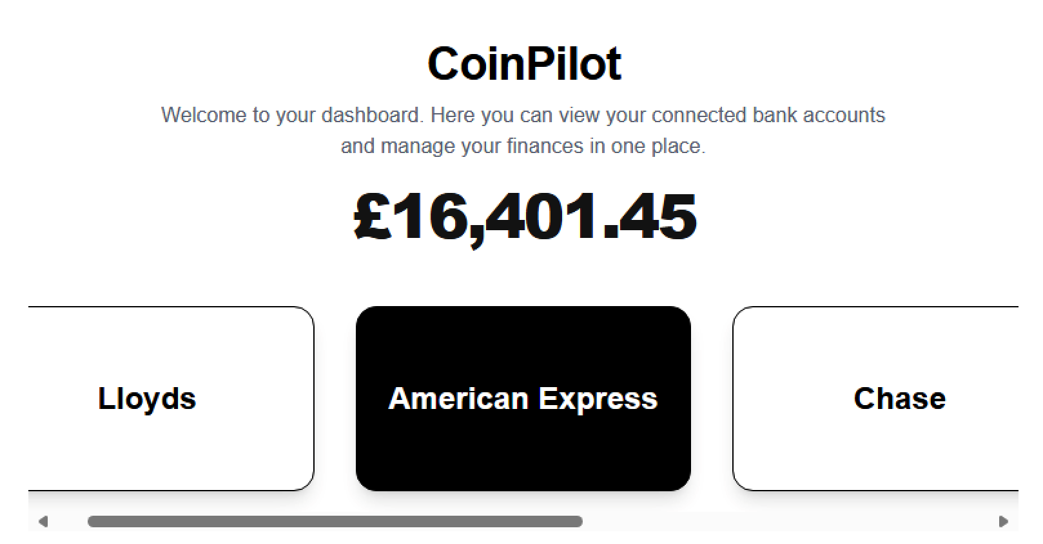
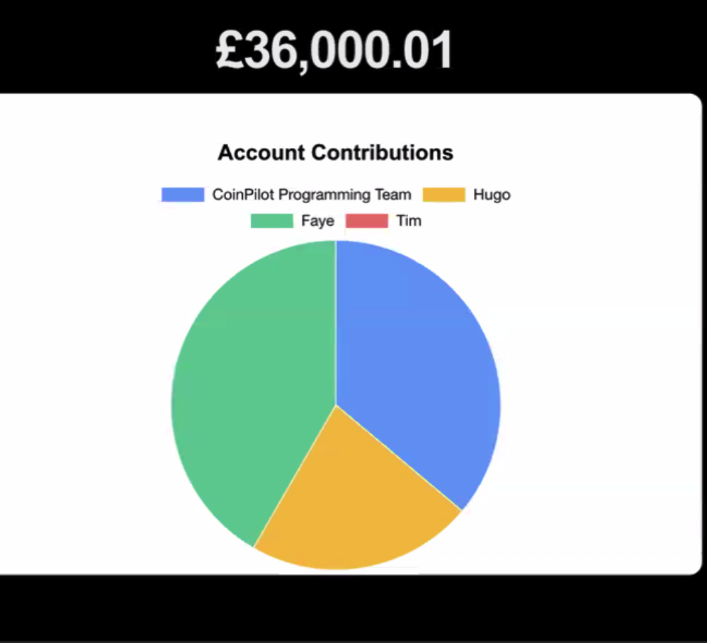
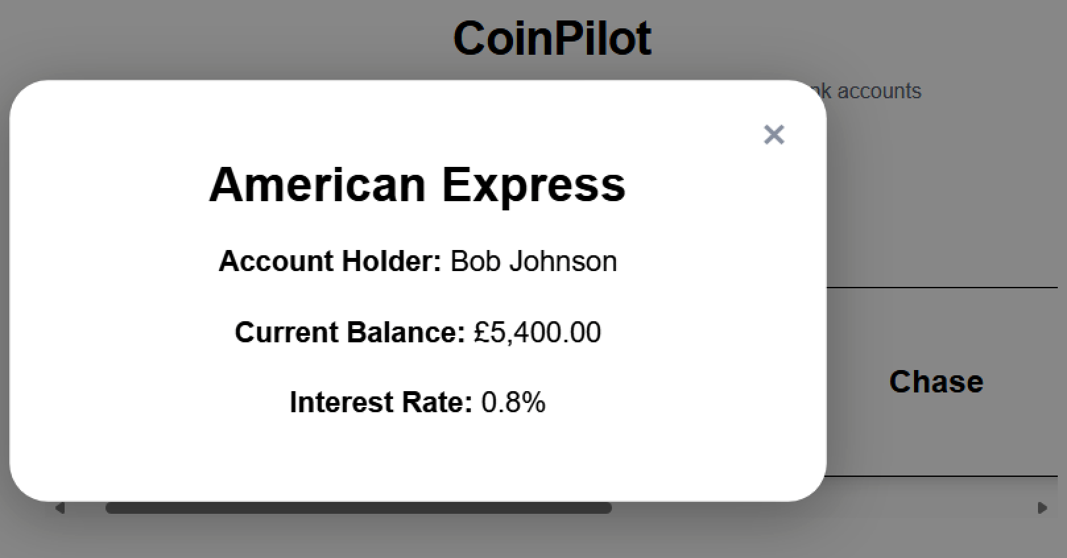
Dashboard Page

Slide 5
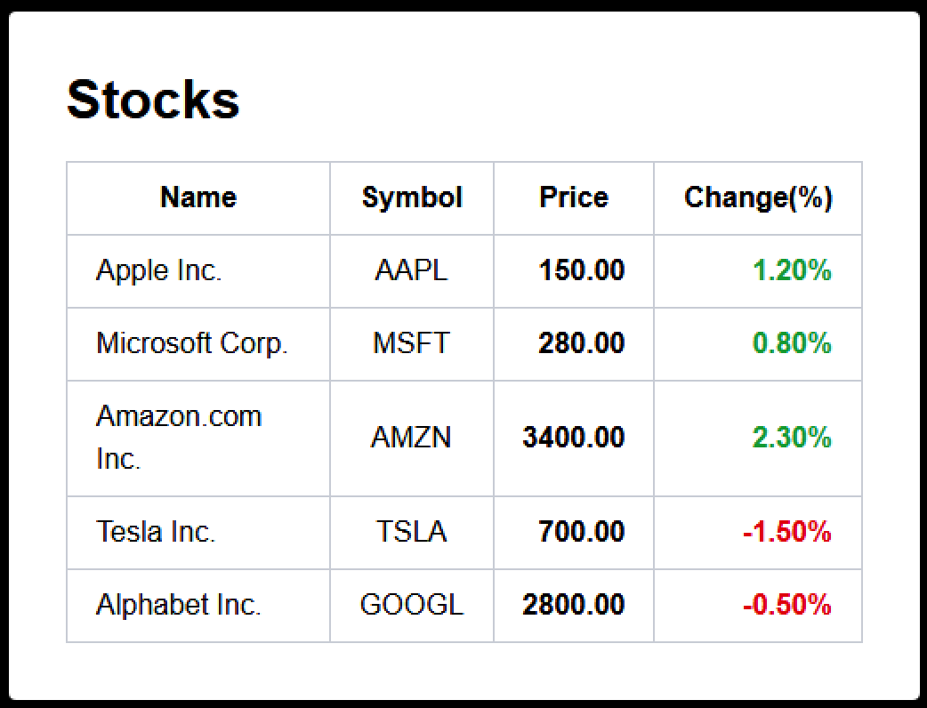
Stocks Page

Slide 6
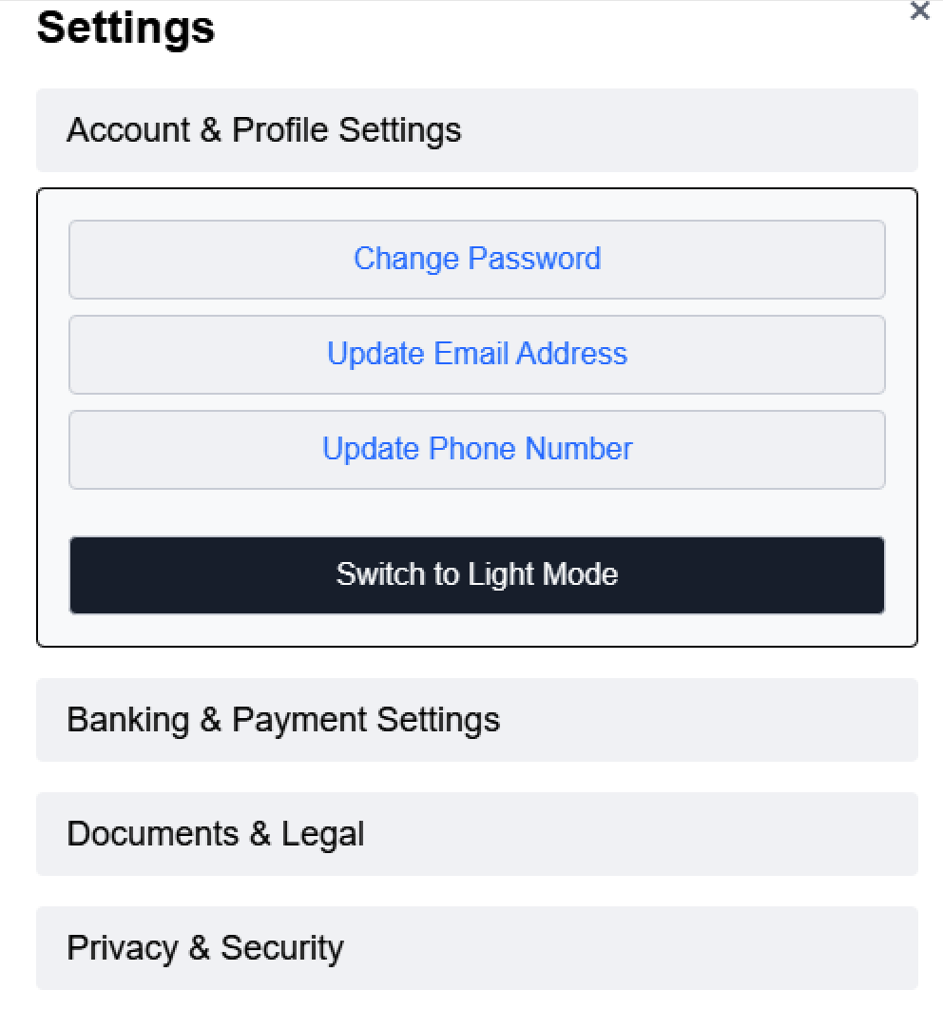

Settings Page

Slide 7

Tests
Tested all models in Django – created a bank account and checked it was created correctly
Tested an API Root – shows total across all bank accounts, checked this output the same value as was in the backend

Slide 8
Useful Prompts
Prefix with #code base – it will find files automatically
Use agent mode it will speed up the workflow
Add a terminal selection to help debug errors

